Slide 1
TEAM 5 Homework2
Course: Programming design and application
Teacher: Mr. Hareesh

Slide 2


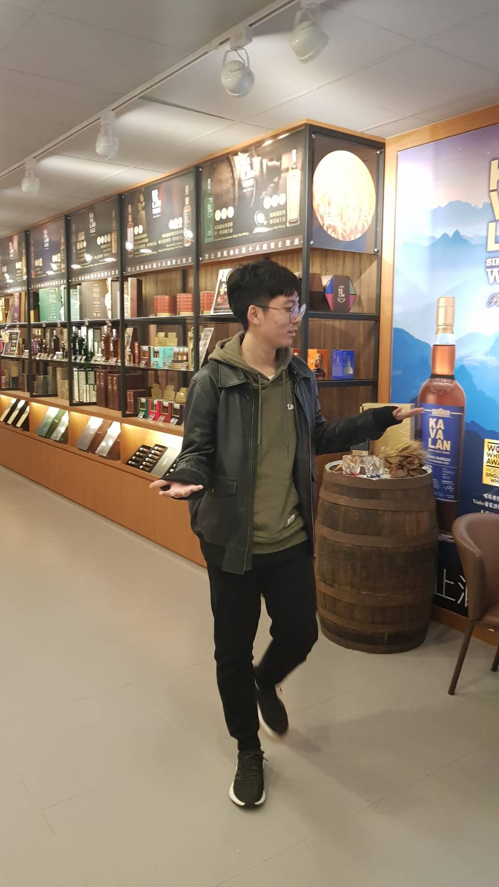
PART 1. Team Introduction
Name | Tseng,Po-Hsien | Lin,Chen-Hsun | Ni, Tzu-Chieh
Picture
Student ID | 107034032 | 107034045 | 107034055
Grade | All Freshman
Contribution | Part1 Introduction Part2 Ideation(part) Part3 science | Part2 Ideation(mainly) Part3 science | Part4 4-steps Part3 science

Slide 3
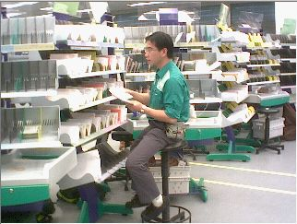
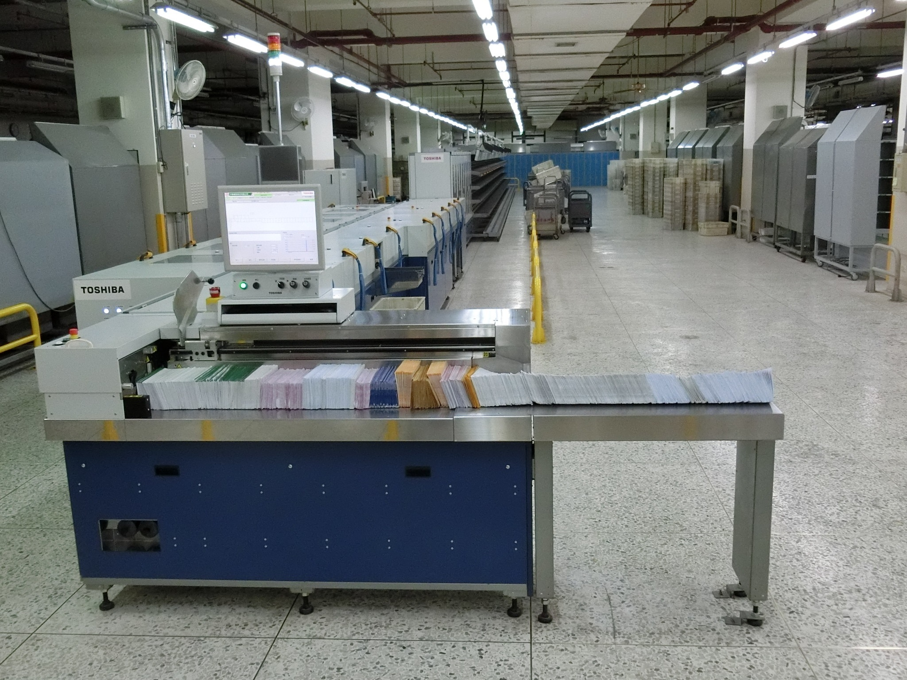
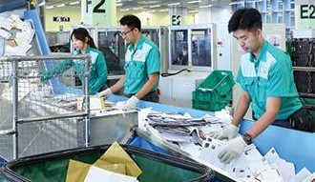
PART2. Ideation(background)
Our idea came from the presentation of how the post office distribute the letters.
(less than 10 in Taiwan)

Slide 4

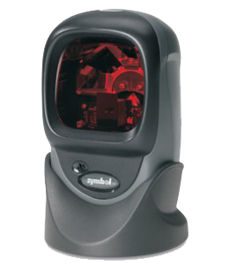
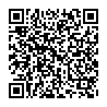


PART2. Ideation
Our idea is stamp + QR code(or others kinds of code) + programing + scanner
In the end, we don’t need stamps anymore!!!!!!
In addition, it’s easier to distribute the letters.

Slide 5

PART2. Ideation
The goal:
1.reduse cost (personnel,stamp)
2. raise efficiency
3.reduce errors
4.improve customers’ satisfacation

Slide 6


PART3. Science Behind
We found letter reduction

Slide 7
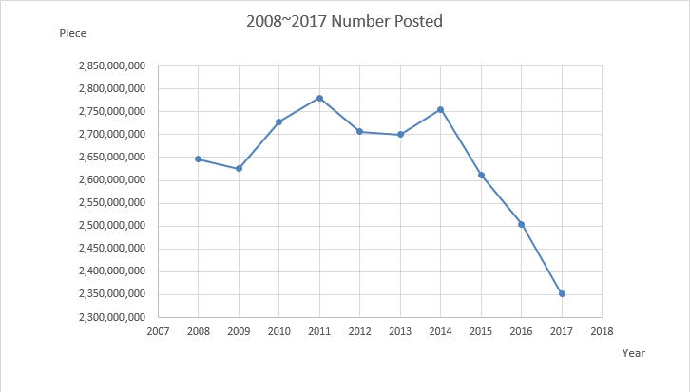
PART3. Science
Notice only correspondence !

Slide 8
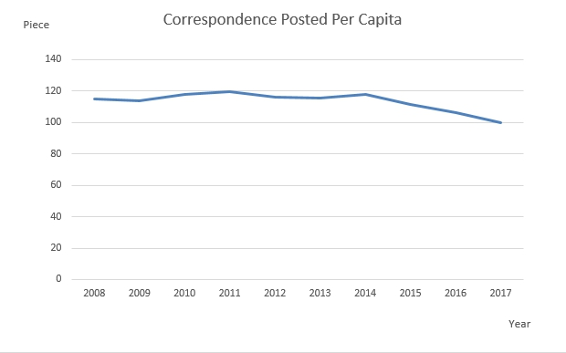
PART3. Science

Slide 9
PART3. Science
Above two graphs, we can see the number of correspondence and correspondence posted per capita, both show the tendency that both are decreasing from 2008 to 2017.
The reason is information technology fast development, more and more people use email. Besides,other companies use low price strategy to take advantage over Chunghwa Post.
That lead to the decreasing number of correspondence. So we don’t have to spend so much money and time on correspondence service.

Slide 10

PART3. Science
According to the result from previous page, we thought we can use resources on more profit items. To increase the total profit or reduce cost.

Slide 11
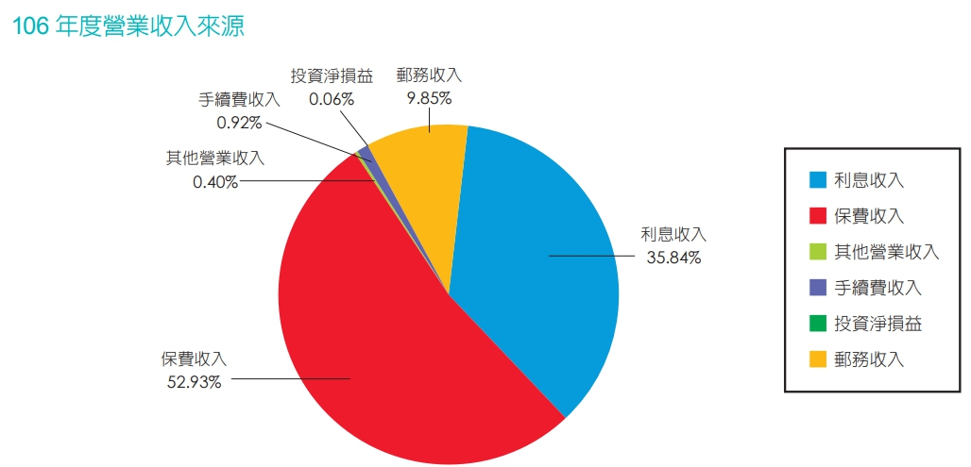
PART3. Science
Postal income
Interest income
Interest income
insurance income
insurance income
Postal income

Slide 12
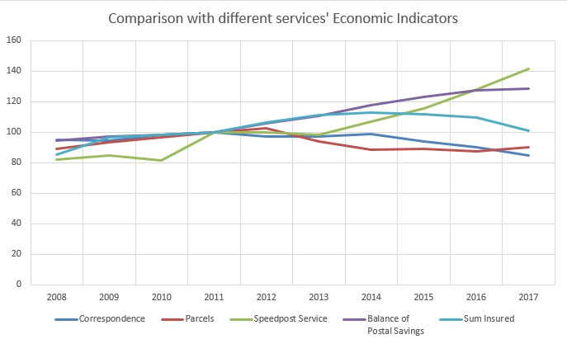
PART3. Science
Correspondence is last.
*An economic indicator is a statistic about an economic activity. Economic indicators allow analysis of economic performance and predictions of future performance.

Slide 13
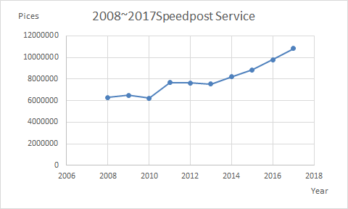
PART3. Science
Notice only speedpos service !

Slide 14

PART3. Science
We can know insurance income is a majority of total imcome. It take the over half total income.
And in the post income, speedpost service is more promising item to earn more profit.
For the reason that we can take the resource of correspondence to insurance or speedpost service.

Slide 15
PART3. Science
Why we choose QRcode?
The advantage of QR code
1.Fast reading
2.High fault tolerance
3.High storage capacity

Slide 16
PART3. Science
1.Fast reading
Original machine | QR code (in ideal situation)
700~800 pieces/minute | 1800 pieces/minute
And QR code has three positioned point, so QR code can be scanned by 360°.
The video of demonstration QR code reading speed.
https://www.youtube.com/watch?v=YGrQl2spyrs

Slide 17
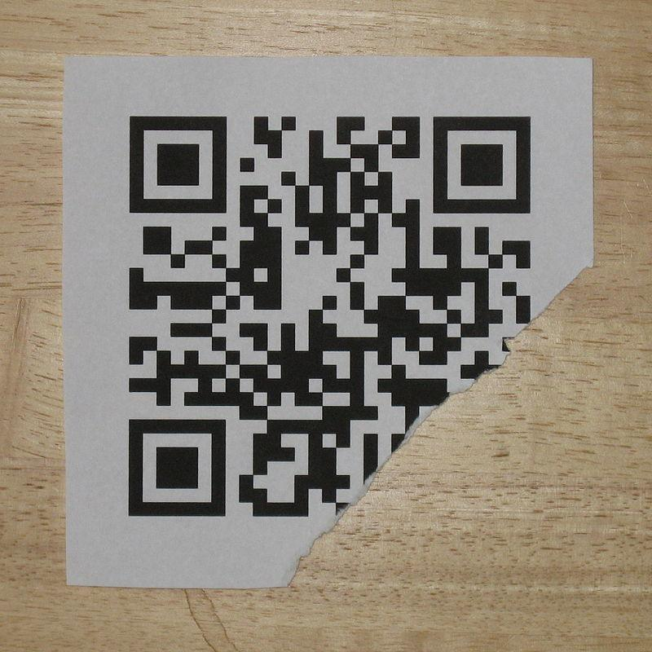
PART3. Science
2.High fault tolerance
What degree damage can still be read?
Error correction capacity
Level L | 7% word can be corrected
Level M | 15% word can be corrected
Level Q | 25% word can be corrected
Level H | 30% word can be corrected

Slide 18
PART3. Science
3.High storage capacity
Maximum character storage capacity
Version | 40
Error correction Level | L(40%)
Numeric only | 7089
Alphanumeric | 4296
Chinese characters | 984(UTF-8)
 | 1800(BIG5)

Slide 19
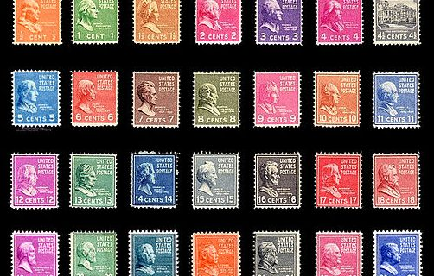
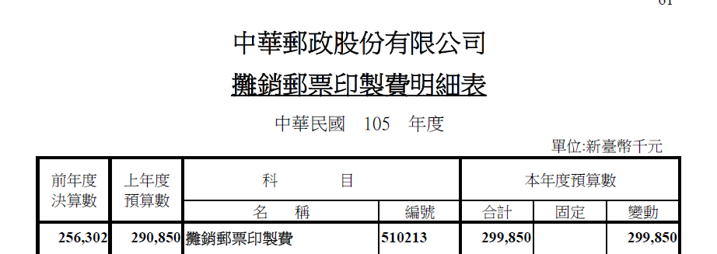
PART3. Science
stamp printing fee
299850*1000=299850000
(nearly 300 million dollars per year)

Slide 20
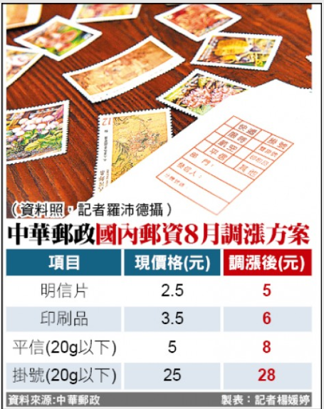

PART3. Science
Why don’t we change the stamps into code??

Slide 21
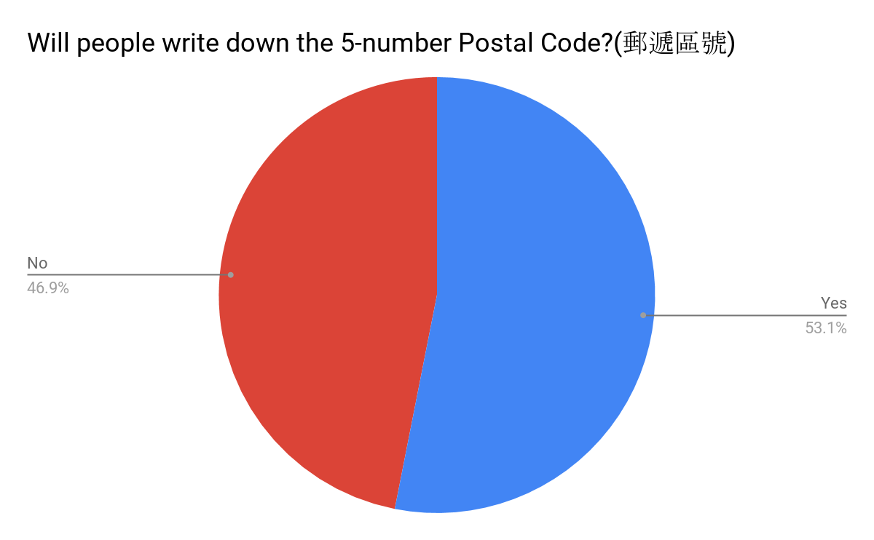
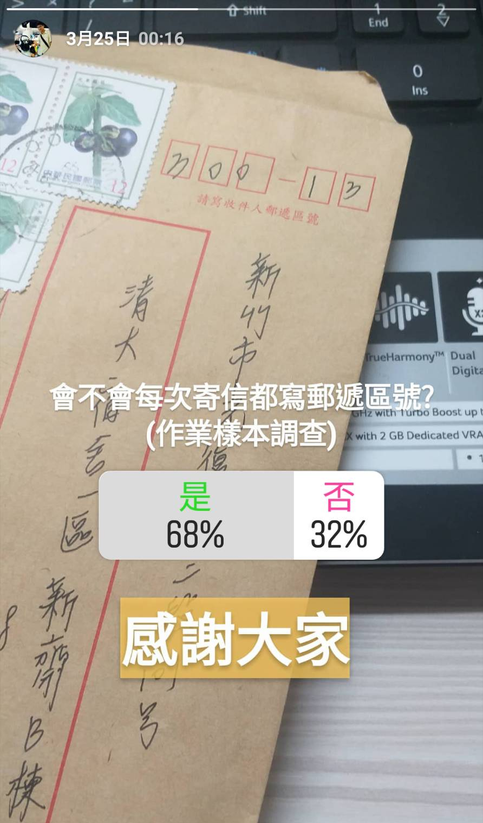
PART3. Science
Postal Code?!?
insert in the QR code
145 responses
77 will
68 won’t

Slide 22
PART3. Science
Personal cost and Time cost
There were more than 2,151,997,318 mails sent by the post office last year.
The cost is 145 $ / 1hr for the people who sort the mail.
The total cost on the wage of sorting the mail will be at less 260,000,000 $
Which it take 0.8$ to pay on each mail just for the sorting guy’s wage.
It take an average 3 sec to sort a mail.

Slide 23
PART4. How?
Design a code maker to product the QR-code-stamp .
Build a sorting machine.
Design a logistics management system to match with the machine.

Slide 24
PART4. How
Design a code maker to product the QR-code-stamp .
The QR-code-stamp we product have to include
Recipient’s / Sender ‘s adderess, Mail’s type, The way to send the mail, Security code
The program to product stamp : (Learn online and ask instructor)

Slide 25
PART4. How
Build a sorting machine.
Learning the basic mechanical knowledge (Online and roomate)
The material of the machine (Buy or ask from the lab)
Scanning technology (Instructor)

Slide 26
PART4. How
Design a logistics management system to match with the machine.
Learning logistics management (By department course)
Learning work study to improve the efficiency (By the department course)

Slide 27
Data Sources
http://www.vmit.org/paper/vol13/13-5.pdf
https://www.post.gov.tw/post/internet/Message/index.jsp?ID=15021002
https://www.post.gov.tw/post/internet/Message/index.jsp?ID=1510

Slide 28
Reference
1.https://www.qrcode.com/en/
2.http://mocfile.moc.gov.tw/ntmhistory/76dc0155-b75f-41be-a1b3-0ec6dc383dea.pdf
3.http://myweb.fcu.edu.tw/~mhsung/NPDP/Tech/2D_Codes/QR_Code.htm
4.https://www.post.gov.tw/post/internet/post_news/post_news_dtl.jsp?news_no=22204
5.https://tw.nec.com/zh_TW/profile/mitatv/mita11-3.html

